Slide 1

Unpacking Assessment
Academic Integrity and Proper Design
Pace University
January 21, 2020
Whitney Kilgore, PhD
Co-founder & CAO, iDesign

Slide 2






















Who we work with:

Slide 3

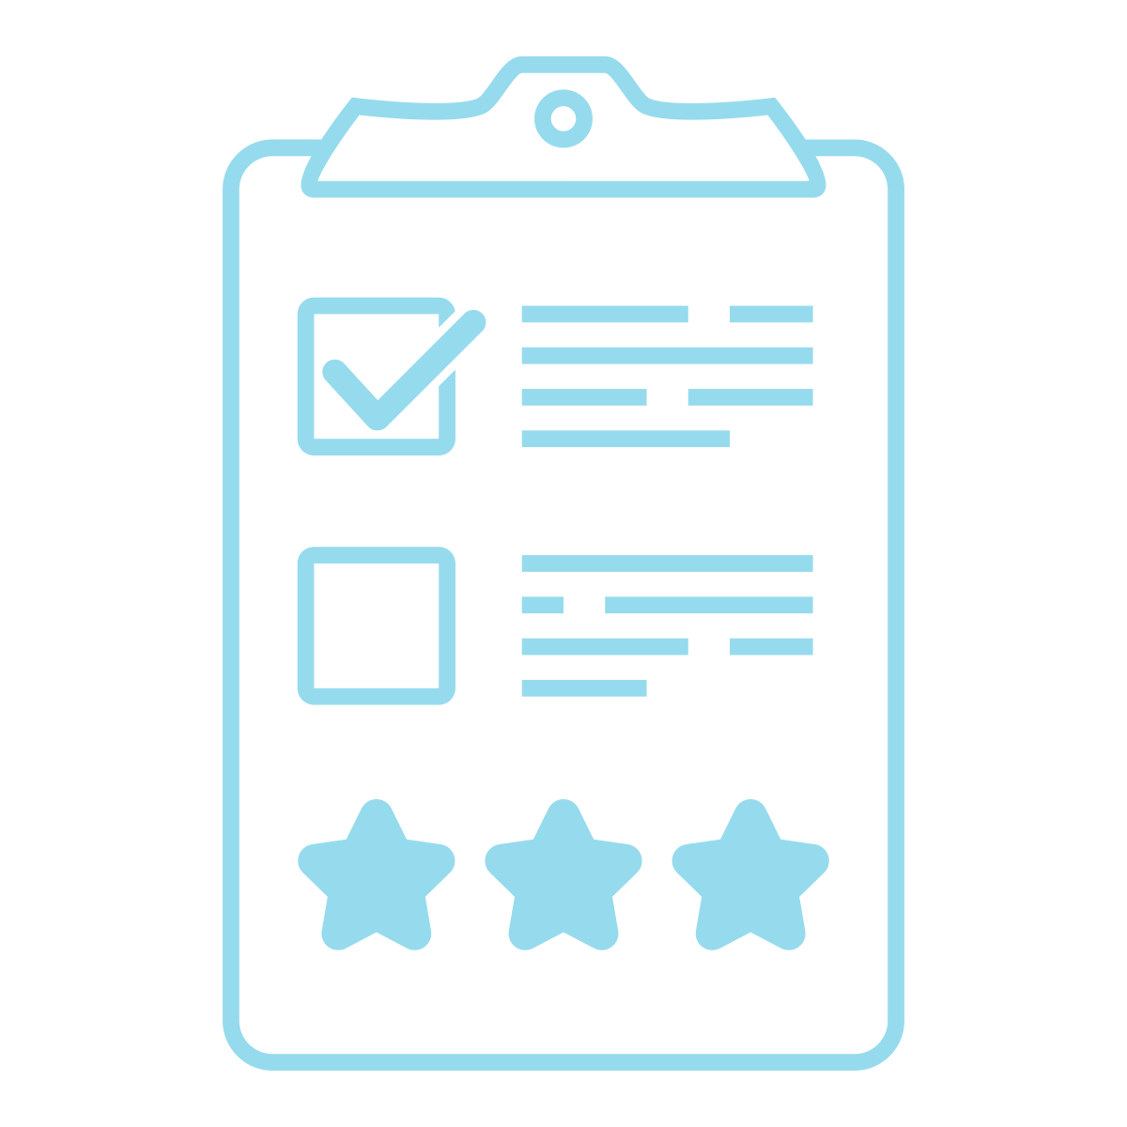









Assessment Approaches
Scaffolding
Rubrics
Academic Integrity
Alignment
Unpacking Assessment

Slide 4
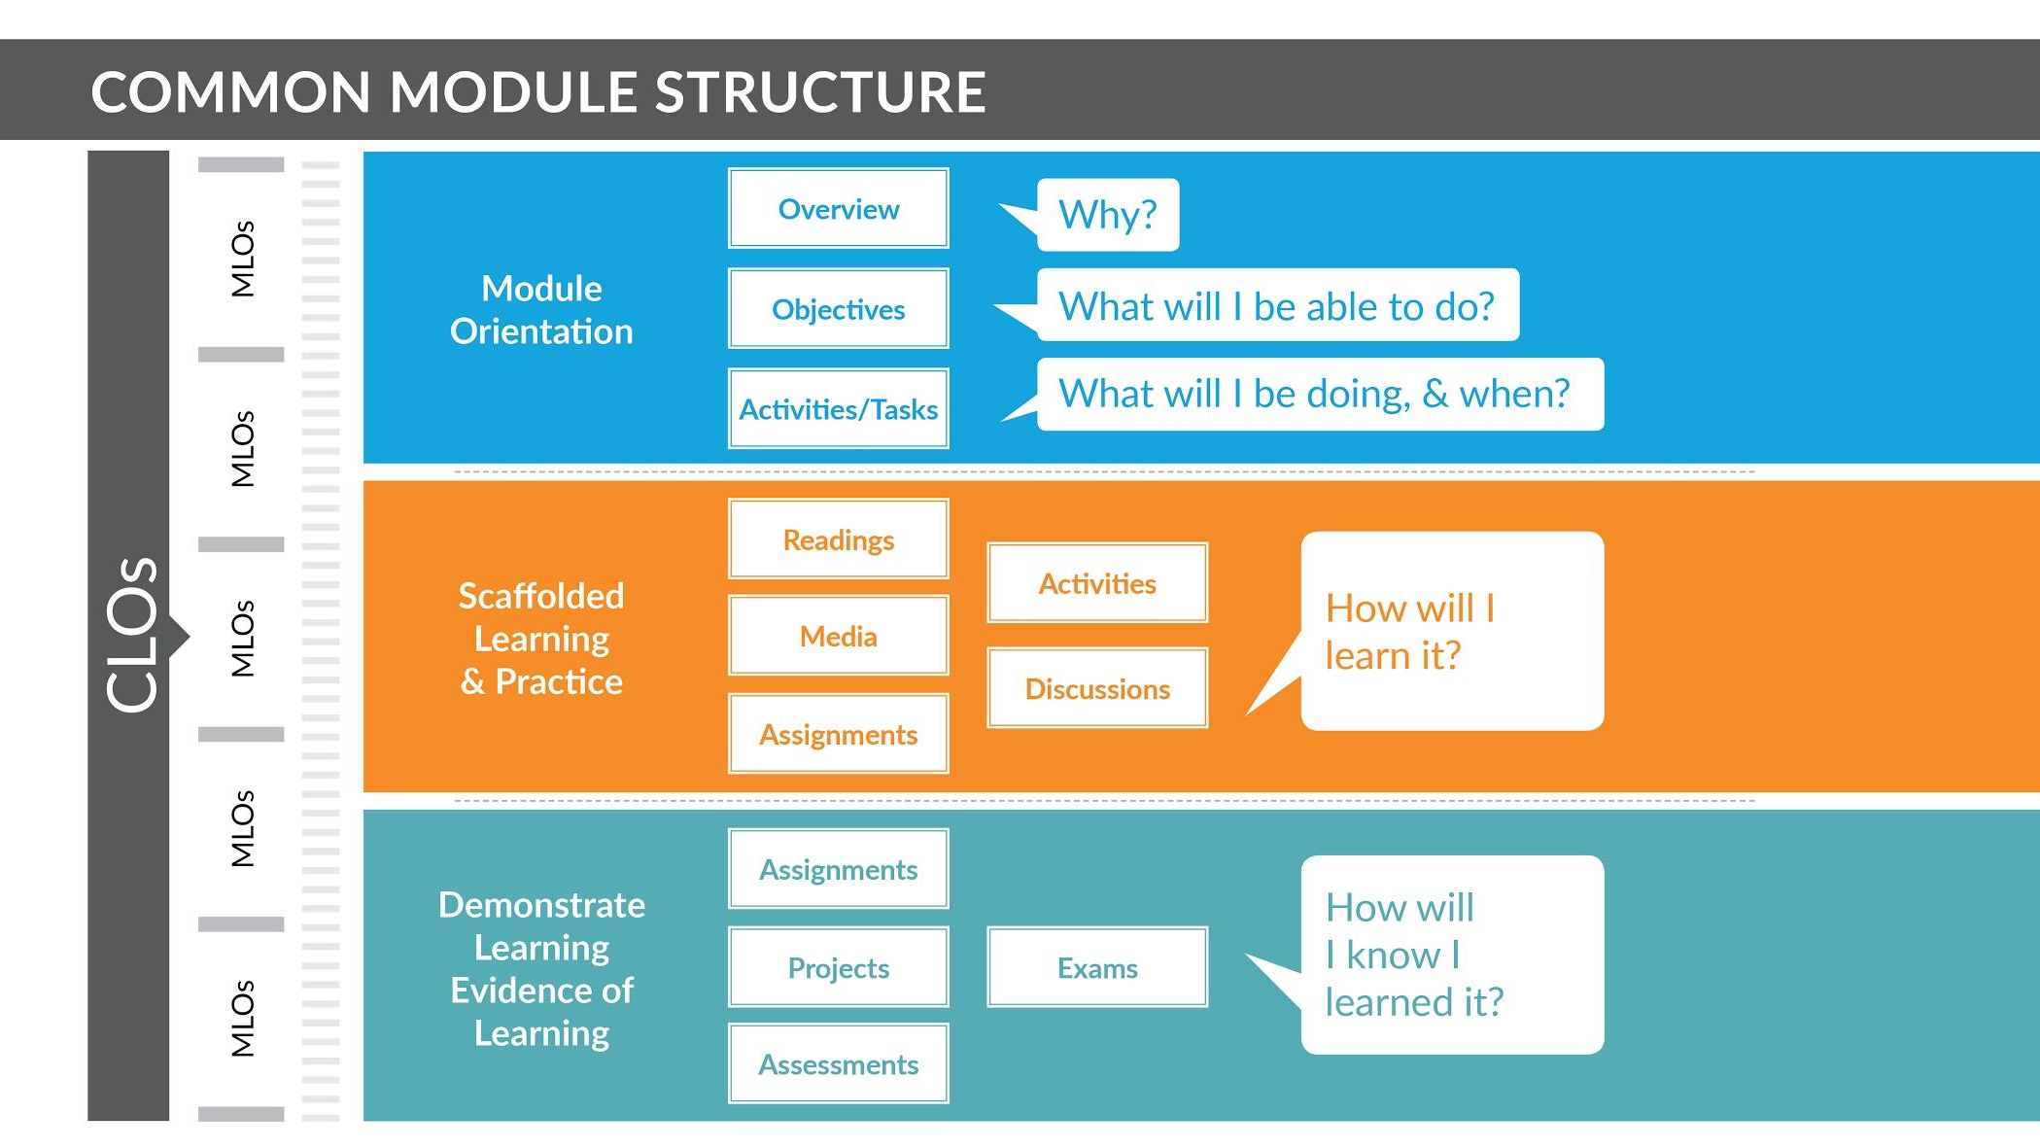

Slide 5
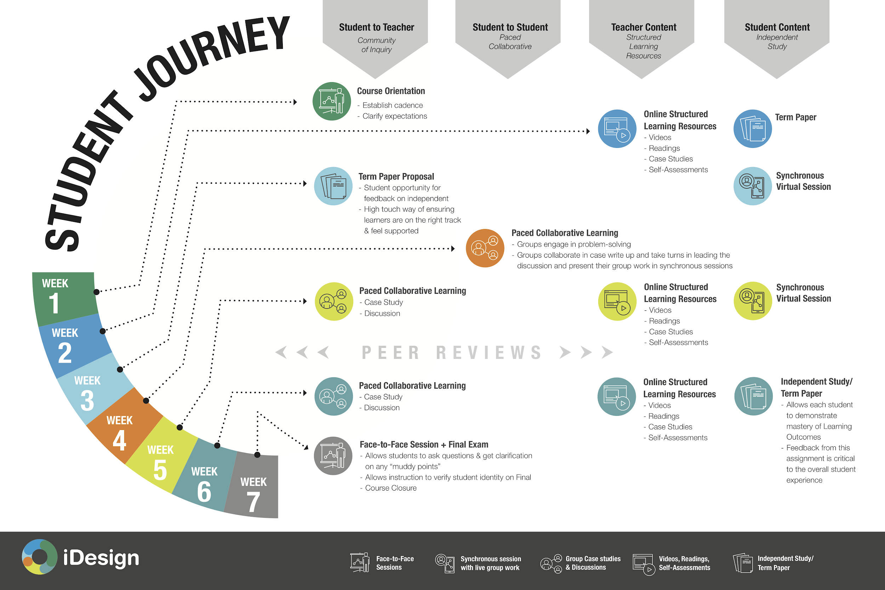
Alignment
Student Journey

Slide 6
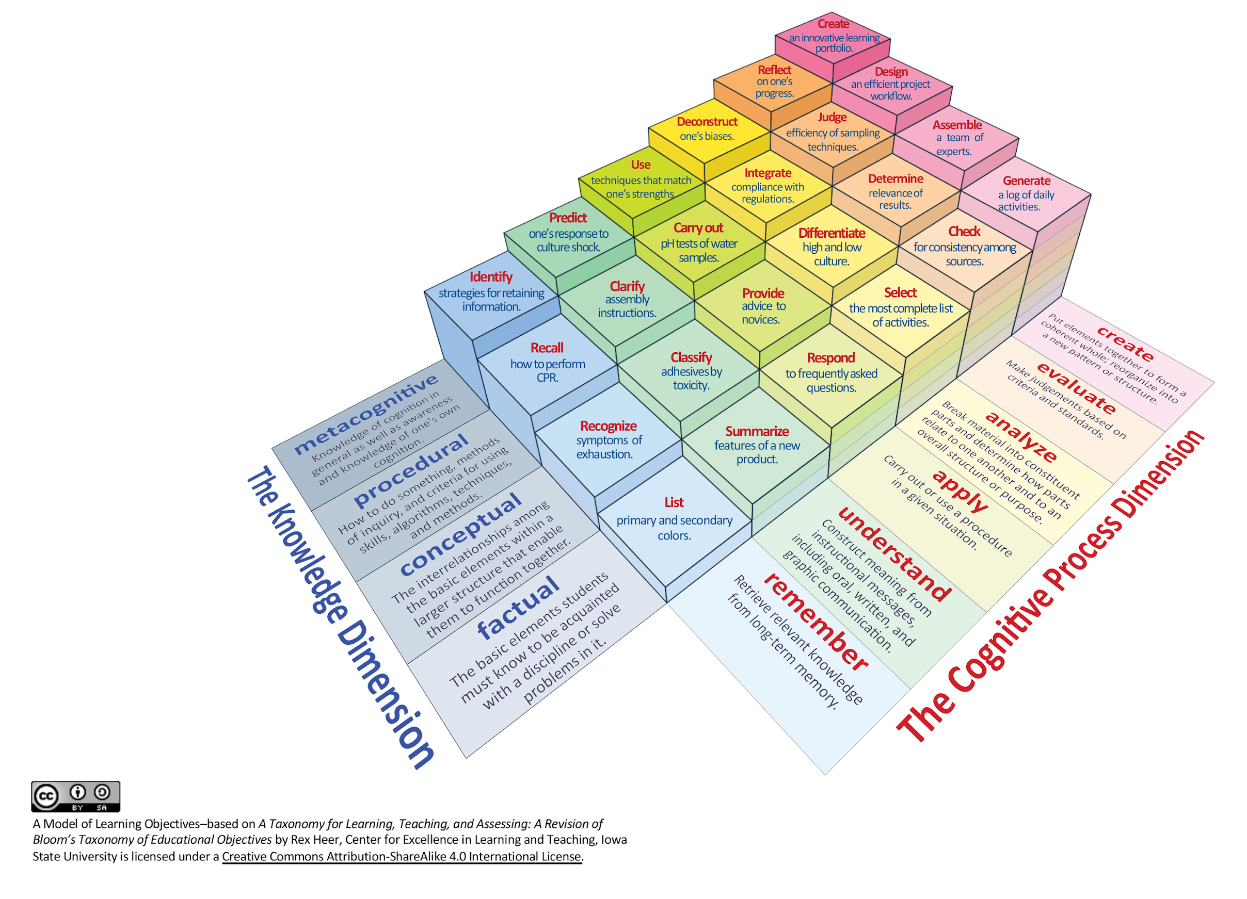
Notes:
Page 3 Iowa state thingy

Slide 7
How do you assess learning?

Slide 8
Assessment Approaches
Multiple choice exams
Essays or papers
Case study
Problem solving
Verbal presentation
Debate and discussion
Product development
Concept map or flow diagram
Performance
Team project
Reflective Essay
Match the assessment to measurable learning objectives

Slide 9
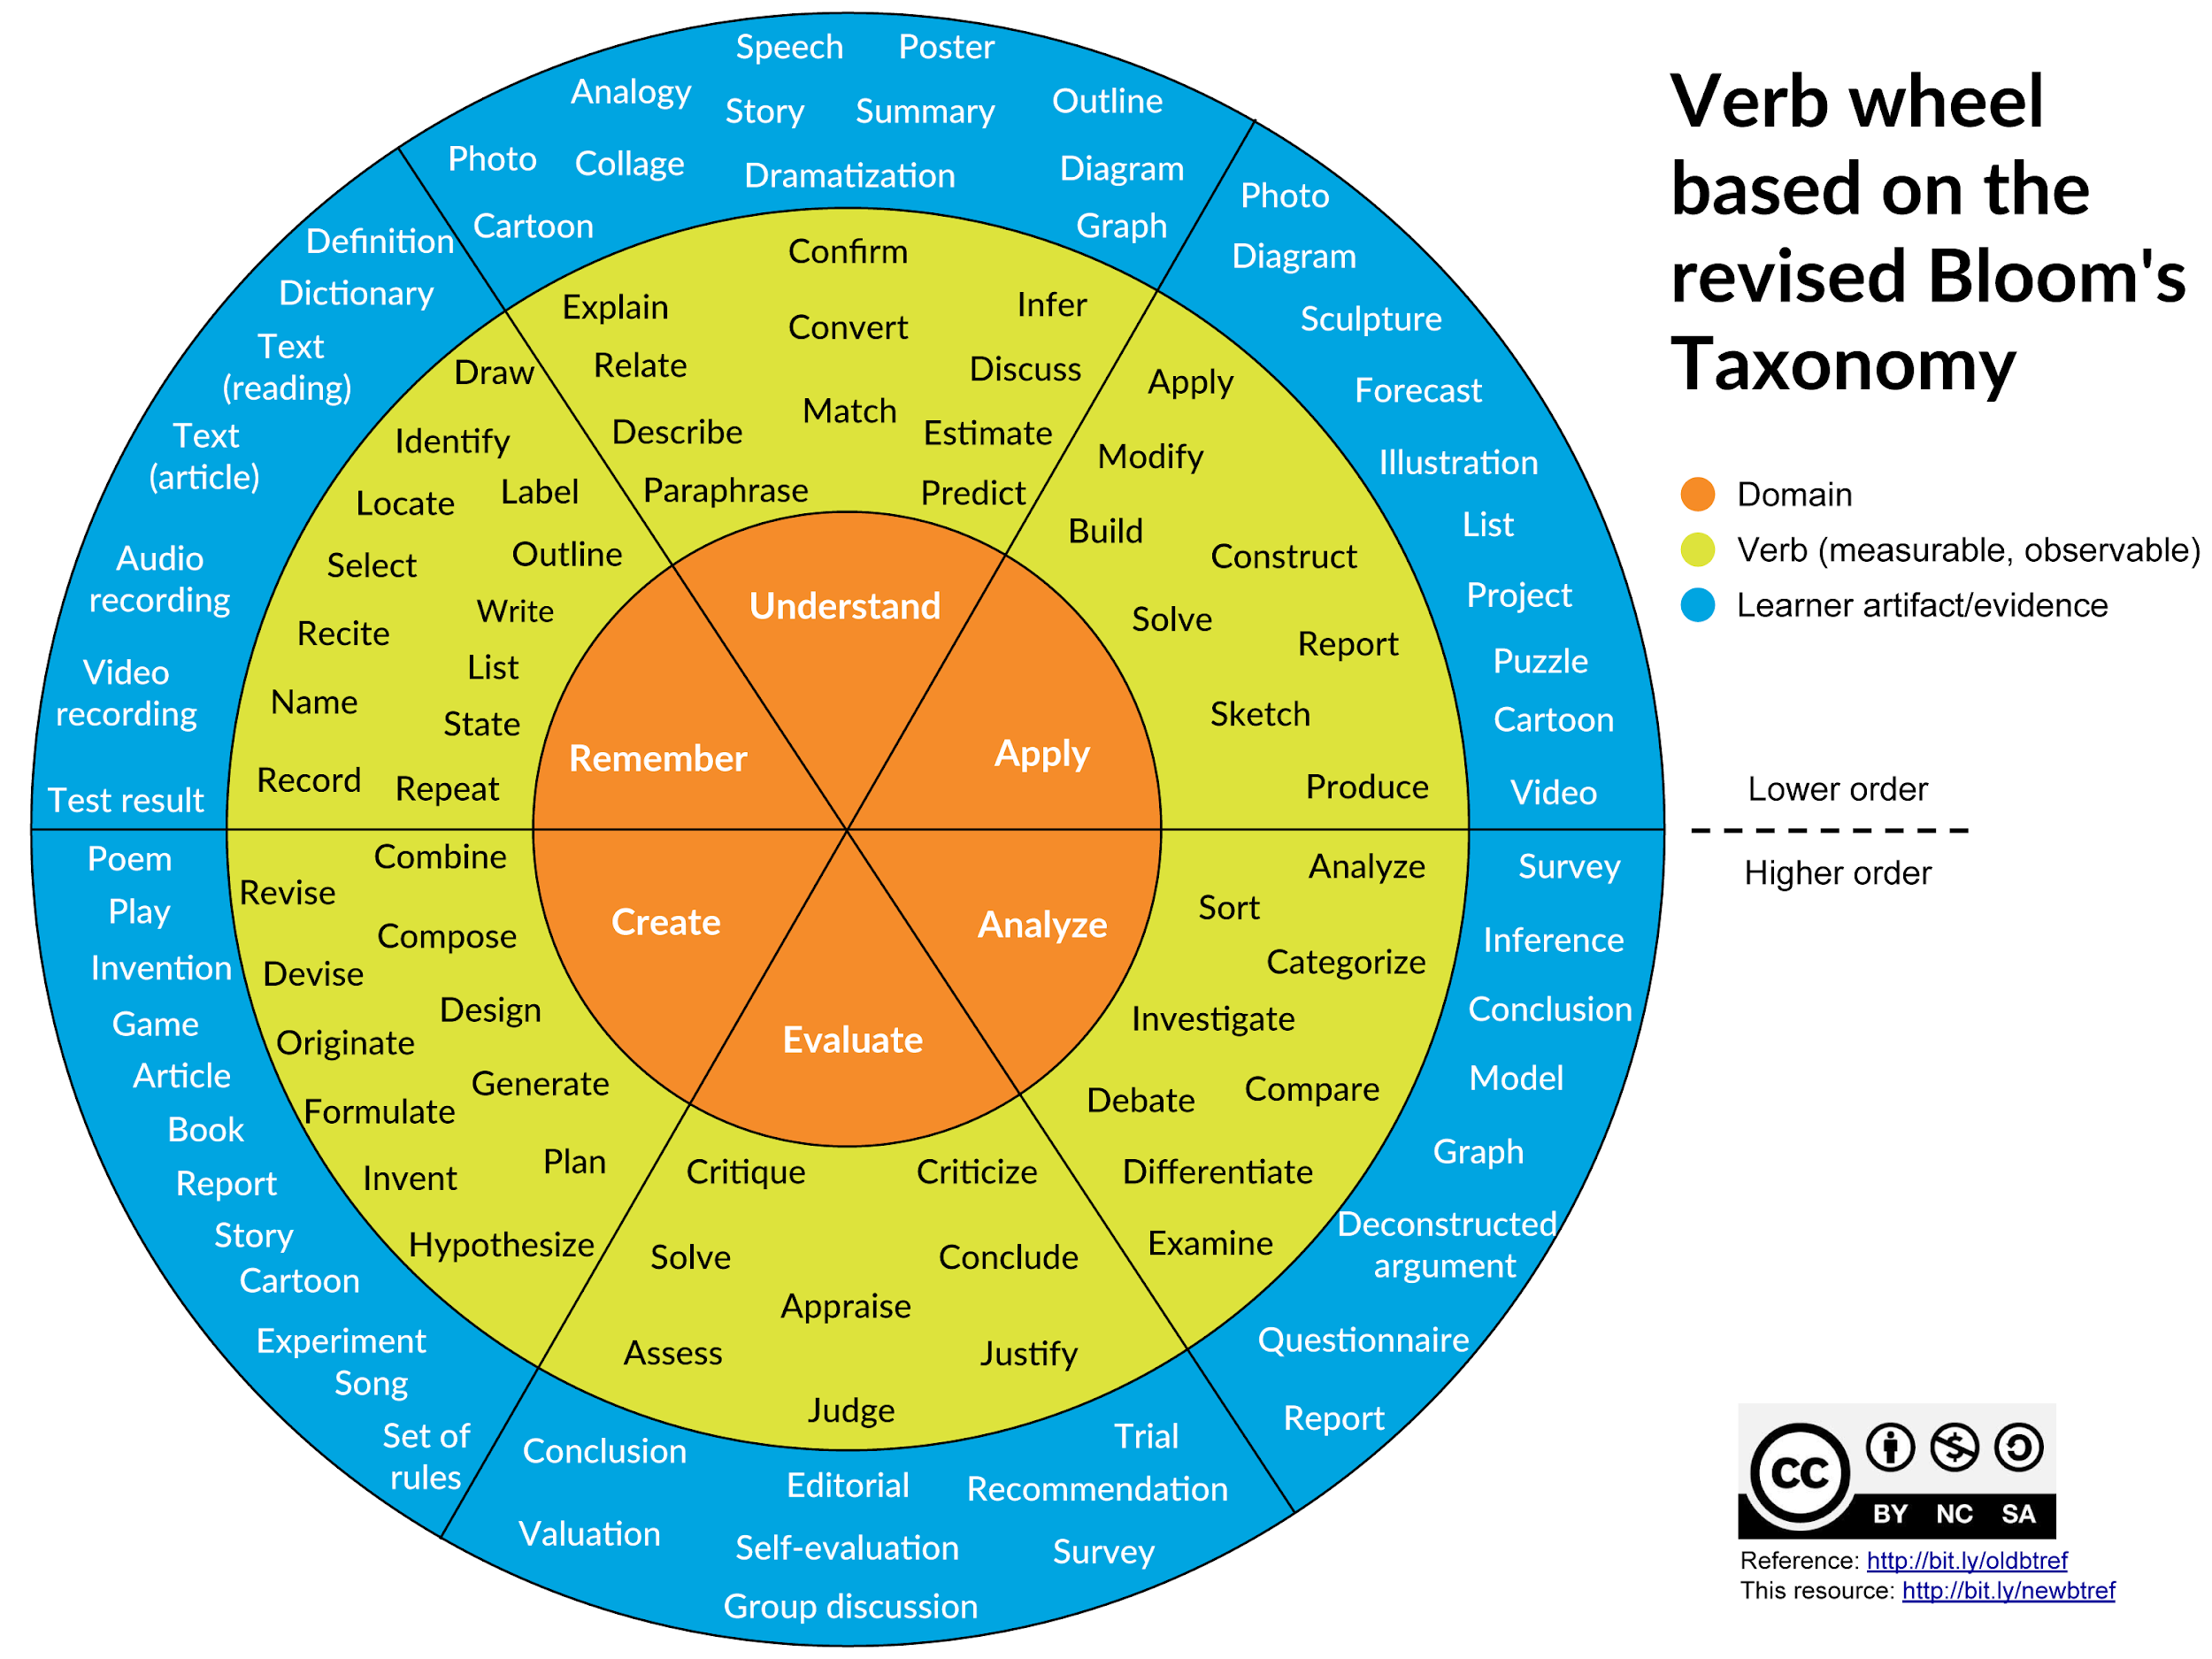

Slide 10
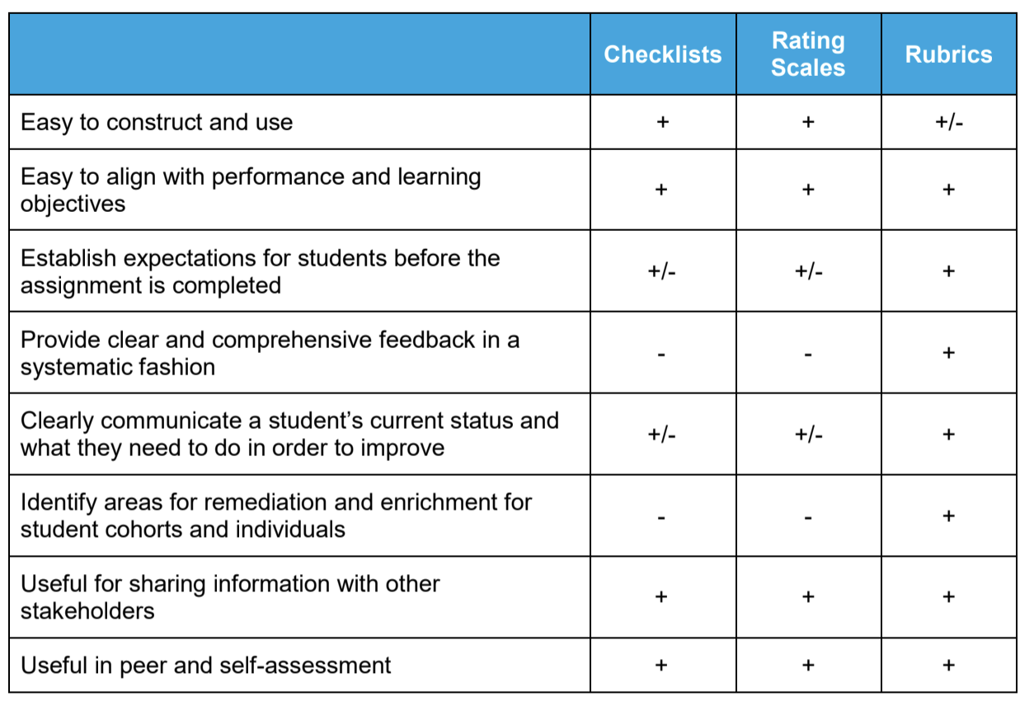

Checklists, Rating Scales, & Rubrics

Slide 11
Academic Integrity

Slide 12

iDeas to support Academic Integrity in the LMS
Move away from high stakes assessments
(i.e. Midterm and Final Exam only)
(i.e. Paper or Project only)
Have students review an academic integrity policy and add a quiz related to academic integrity into courses or student orientation
Automated Assessments in the LMS should
Use Question Banks/Pools
Limit time allowed
Randomize questions and answer choices

Slide 13
