Slide 1
Best Practices and Approvals
January 21, 2020
Joe Seijo, Instructional Designer
When to Copyright!
Nancy Uhl, Assistant Director of Instructional Design
Measuring Instructional Time!
Nancy Hale, Executive Director of PESP Program Development and Strategy and Associate Professor Seidenberg
Establishing our Capabilities to Deliver Programs Online—Regulatory Issues!

Slide 2
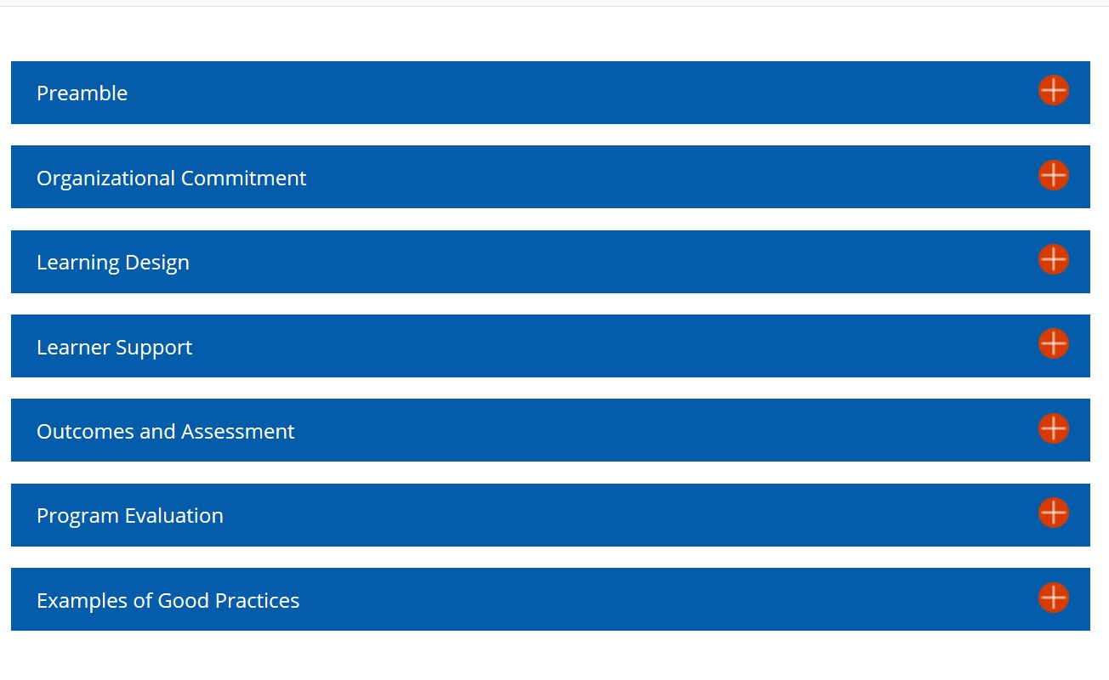
NYS Distance Education
Program Principles of Good Practice* Est. 2001
http://www.nysed.gov/college-university-evaluation/distance-education-program-principles-good-practice

Slide 3
Learning Design
Using Copyrighted Works in your Online Class
Copyrightable works:
Literary works
Musical works, including any accompanying words
Dramatic works, including any accompanying music
Pantomimes and choreographic works
Pictorial, graphic, and sculptural works
Motion pictures and other audiovisual works
Sound recordings
Architectural works

Slide 4
Using Copyrighted Works in your Online Class
Works not eligible for copyright protection:
Ideas, theories, concepts
Procedures, methods, processes
Titles, names, short phrases and slogans, familiar symbols or designs, variations of type styles, lists of ingredients
Facts
Works consisting entirely of information that is common property and containing no original authorship (e.g. standard calendars, height and weight charts, tables taken from public documents)
Works of the U.S. government
Notes:
Each person can introduce themselves then use 8-10 minutes to showcase their unit. Ex, Beth can show the digital toolkit, Joe can show a glimpse into the faculty training, etc. Nick can close this slide by showcasing the Faculty Media Center ( Jaime will speak to it, but Nick can provide a “tour”)

Slide 5
Using Copyrighted Works in your Online Class
Quick Tips:
Videos available freely online (YouTube, Google, TedTalks, etc.) can be used in an online class.
Open Educational Resources (OER) can be used freely in an online class.
Videos from NBC Learn and Lynda.com can be used in an online class because Pace University subscribes to these platforms and these are integrated with Blackboard.
Posting OER videos/images, or those found freely online, to an outside blog or site is acceptable.
Posting films provided by our library to outside blogs or sites is not acceptable.
When in doubt, limit the copyrighted work to students enrolled in your class and state that students cannot copy or download.
Allowing students to copy or download films provided by our library is not acceptable.
Notes:
Each person can introduce themselves then use 8-10 minutes to showcase their unit. Ex, Beth can show the digital toolkit, Joe can show a glimpse into the faculty training, etc. Nick can close this slide by showcasing the Faculty Media Center ( Jaime will speak to it, but Nick can provide a “tour”)

Slide 6
Using Copyrighted Works in your Online Class
Copyright law contains these exceptions:
Section 107: Fair use — Permits use of copyrighted material without acquiring permission. Examples of fair use include criticism, comment, news reporting, teaching (including multiple copies for classroom use), scholarship, and research.
Section 108: Library copying — Allows libraries to make copies of works for preservation, research and study, and interlibrary loan.
Section 109(a): First sale doctrine — Limitation on the copyright holder's distribution right that states that once a copy of a work has been lawfully sold, the owner of the copy is free to resell it, rent it, loan it, or give it away. Allows for library lending, video rentals, used book and CD sales, and the ability to give copyrighted materials as gifts.
Section 110(1): Displays and performances in face-to-face teaching — Allows for the performance and display of copyrighted materials in the course of face-to-face teaching at nonprofit educational institutions.
Section 110(2): Displays and performances in distance education (TEACH Act) — Ability to display or perform certain types of copyrighted works in the course of distance education.
Section 120: Architectural Works — Anyone may take and use photographs of publicly visible buildings without infringing the copyright in the architectural design.
Notes:
Each person can introduce themselves then use 8-10 minutes to showcase their unit. Ex, Beth can show the digital toolkit, Joe can show a glimpse into the faculty training, etc. Nick can close this slide by showcasing the Faculty Media Center ( Jaime will speak to it, but Nick can provide a “tour”)

Slide 7
Learning Design
Determining Credit Hours in an Online Course*
A typical on campus 3 credit course meets 3 times per week for 1 hour periods over a 15 week semester
3 credits x 15 weeks = 45 instructional hours per course
An additional 2 hours of individual study time is expected for each hour spent in the classroom thereby requiring and additional 90 hours of studying for a 3 credit course.
45 instructional hours + 90 individual study hours = 135 total hours
9 hours per week of course engagement
* http://www.nysed.gov/college-university-evaluation/distance-education-program-policies

Slide 8
Determining Credit Hours in an Online Course
In an online class instead of looking at contact hours we want to calculate time on task. This is done by estimating how long it will take the average student to complete all of the assignments for that week, including reading assignments, videos, quizzes. discussions, group work, etc.
Task | Time
Viewing three, 15-minute lectures (text and/or video), with web links | 1 hour
Reading assignments | 2 hour
Completing a 10-item online quiz | 1 hour
Posting to discussions (original post, responses to three classmates’ posts, responses to responses) | 2 hours
Written assignments | 1½ hour
Work on final research paper and/or presentation | 1½ hours
Total | 9 hours

Slide 9
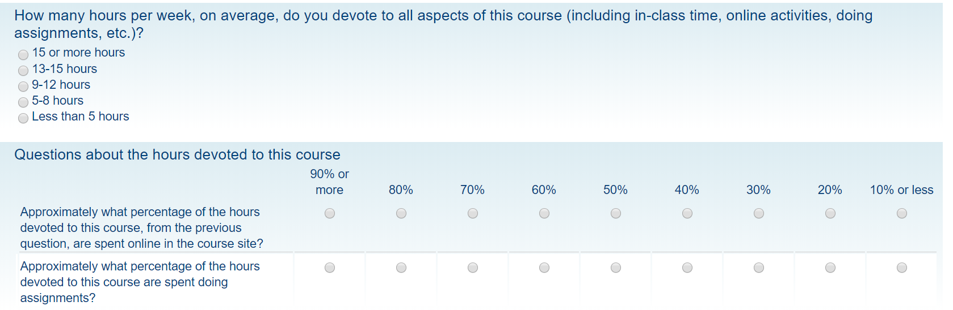
Determining Credit Hours in an Online Course
  We also survey the students to determine how much time they are spending on each course.

Slide 10
Organizational Commitment
When do you need the NYS DETST format?
The NYS Distance Education Format is required when a program offers one-half (50 percent or more) of the course requirements at a distance.
On-campus work may be required in some programs but it must be limited to 49 percent.

Slide 11
Why do we need to add the DE format to programs?
A student who enrolls in a program offered in New York that is not SED-approved may not be eligible for state or federal student financial aid.

Slide 12
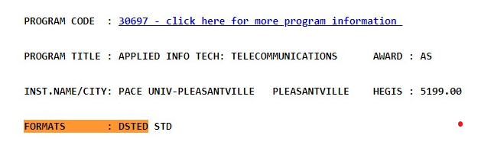
How to determine if a program has the Distance Ed format?
Check New York State Inventory of Registered Programs by State http://www.nysed.gov/heds/IRPSL1.html.

Slide 13
How is a Program Delivered?
Issues
Delivery Formats
Programs are registered through NYSED with a format
  STD Program a program is delivered on ground with no more than 49% delivered online.
  DSTED A program that is delivered 50% or more online, requires a Distance Ed format approval from NYSED.
How does the applicant know how a program is delivered?
Traditional All degree courses are 100% on ground with a maximum of 49% taught online. Students are required to come to campus.
Fully Online All degree courses are available 100 percent online in asynchronous or synchronous formats. Program may have an “optional” residential component. Requires DE Format
Blended: Between 50% and 99% of the program is delivered online. Students may be required to come to campus. Requires DE format.
Campus | Pace University has three registered campuses NYC (1) PLV (2), and White Plains (3). Programs are registered for delivery on one or all of our campuses. When a program adds a distance ed format to the program registration with NYS, 51 percent or more of its instruction is offered online. Programs with the NYS distance ed format are coded as campus 4 with a secondary code of 1, 2, or 3 to indicate the physical campus delivering the degree's support services.
1 | Instruction and/or support for the program are delivered from New York City Campus
2 | Instruction and/or support for the program takes place from the Pleasantville Campus
3 | Instruction and/or support for the program takes place from the White Plains Campus
4* | Degree is registered with the Distance Ed format requiring that 51 percent or more of the degree is taught online.

Slide 14
Processes and Approvals
NYS Process for Adding Distance Format
  http://www.nysed.gov/college-university-evaluation/proposal-register-general-academic-program
  Part A: Institutional Capabilities (on file with NYS)
  Organizational Commitment
  Learner Support
  Part B: Program Specific Issues (required information)
  Program Design
  Program Evaluation
Pace Forms and Program Internal Pace Approvals
  https://pace.edu/provost/academic-policies-forms

Slide 15
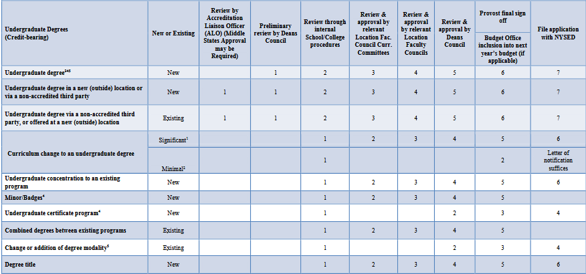

Slide 16
National Council of State Authorization of Reciprocity Agreements (NC-SARA)
https://www.nc-sara.org/resources/nc-sara-information-sheet-revised-september-3-2019
  provides a voluntary, regional approach to state oversight of postsecondary distance education.
  protect students and provide benefits to both states and institutions carrying out distance education in multiple states.

Slide 17
NC-SARA Compliance and
Annual Reporting
Report the number of students studying in our online programs discipline.
Report out-of-state, credit-bearing learning placement report by program areas.

