Slide 1

Pace University
All Campus and Partnership Overview
Presented by:
Samantha Goldstein, Senior Director of Strategic Partnerships
Jack Harney, Senior Director of Strategic Partnerships
Katie Curran, Director of Client Services

Slide 2





What Makes All Campus Special?
Proprietary Technology
Creative Agency Roots
Flexibility of Offering

Slide 3








Our Clients
More than 60 online programs – primarily at the master’s level
Over 9,000 students currently enrolled across partnerships

Slide 4
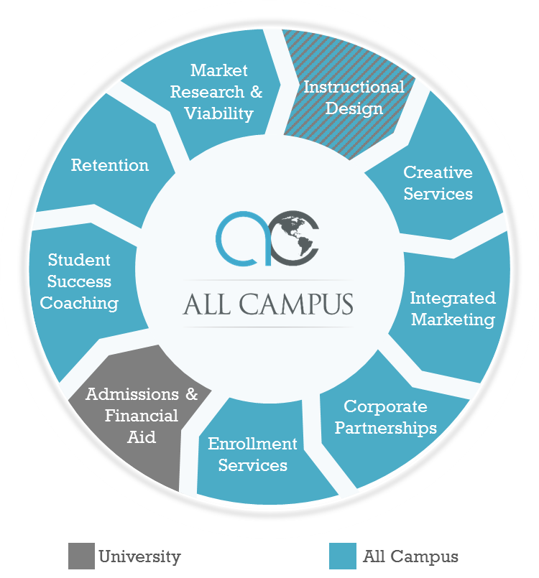
Services Overview

Slide 5





Seamless Team Coordination
Research
Search
Marketing
Integrated
Marketing
Content
& Design
Enrollment
Services
Online program viability
Competitive landscape
Tuition comparison
Brand value index
Search demand
Career outlook
Student satisfaction
Strategic SEO
PPC buying
On-page optimization
Link building
Content production
Vigilant campaign monitoring
Continuous optimization
Banner advertising
Retargeting
Social media
Direct mail & email
Digital radio
Digital video
Niche websites
Webinars, events & B2B
Print
Digital media
Websites
Landing page development & testing
Print media
Direct mail
Video production
Radio production
Mobile responsive digital assets
Experienced enrollment professionals
Program experts
Prospect nurturing
Chat
Re-marketing
Social media management
Student on-boarding
Retention

Slide 6

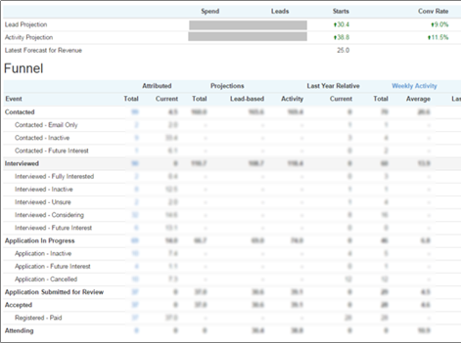
Results Powered by AC Technology
All Campus’ proprietary platform imports campaign data and reports real-time student projections based on:
  Inquiry mix
  Inquiry timing
  Early indicators
  Historical performance
  Benchmarks
Predictive analytics drive media team campaign adjustments to meet enrollment goals

Slide 7

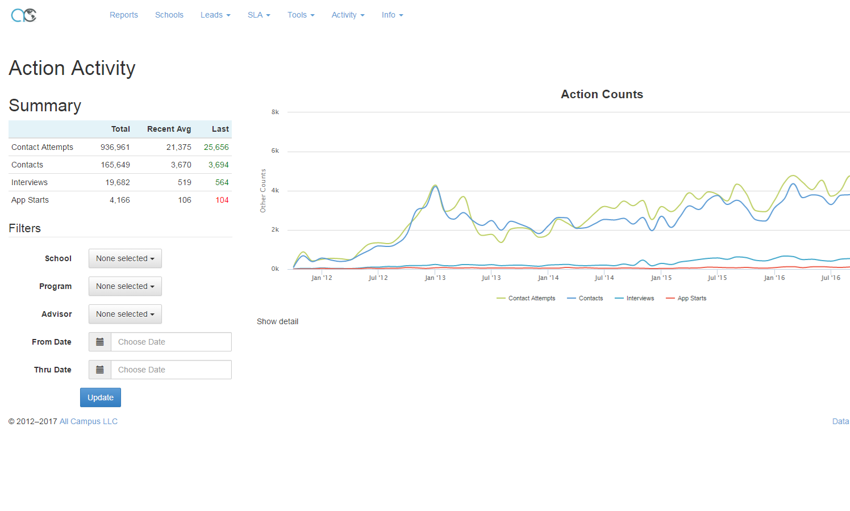
Results Powered by AC Technology
Manage/track inquiries and admissions performance
Email communication based on application stage
Provide better “customer” care
Optimize channel performance
Coaching for Success:
  Upfront coaching
  LMS orientation
  Time management skills
  Registration support

Slide 8
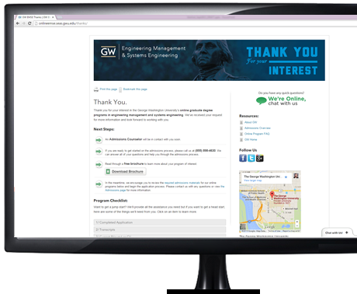

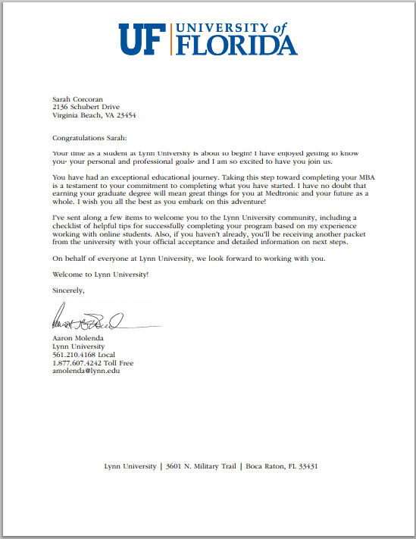

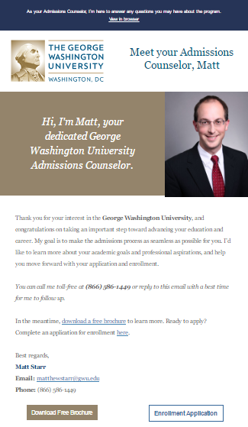

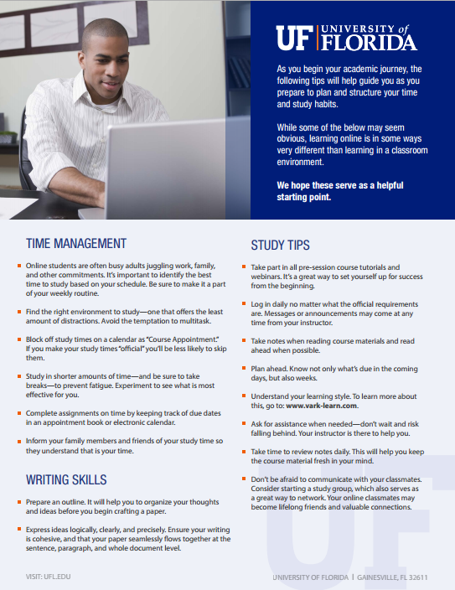


Personalized Nurturing Approach
Chat-enabled sites
Thank you experience with application checklist and brochure
Personalized email campaigns
Welcome kit

Slide 9

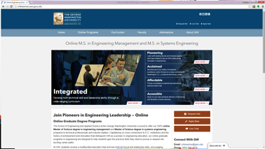
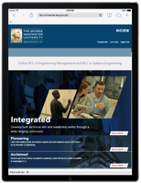

Creative Assets Included at Launch
Program site development
Typically loosely based on the design of the “parent” site for seamless transition/usability
Fully optimized for organic search engines using best-practices
Mobile responsive designs adapt to tablets and phones automatically
Incorporates tried-and-true calls-to-action and multiple inquiry paths

Slide 10
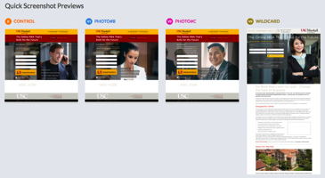
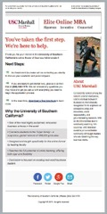
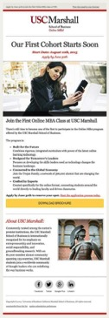
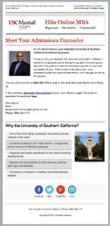
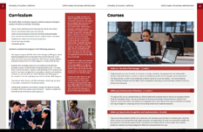
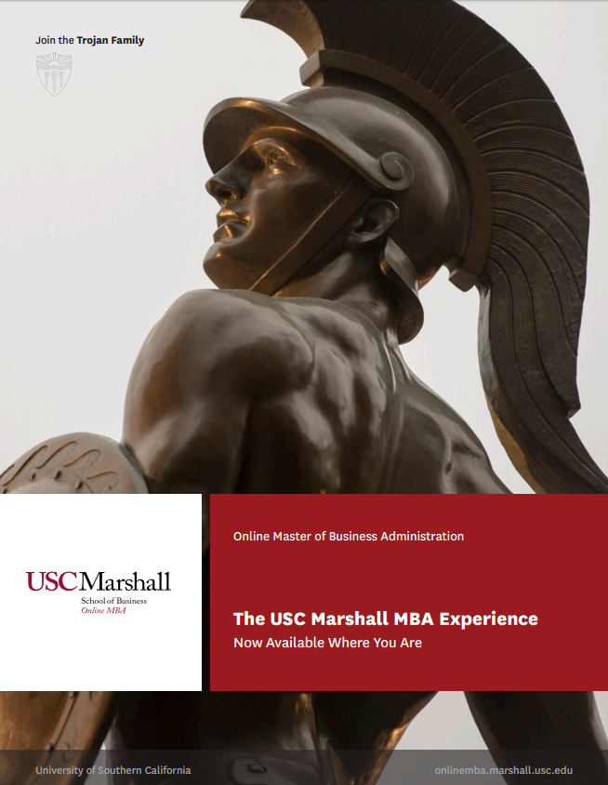




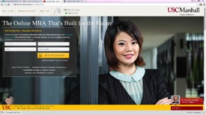



Creative Assets Included at Launch
Multiple request information page designs
Program brochure(s)
20+ nurturing emails
Display banner sets
Social media ads
Social media page creation & management
New student orientation

Slide 11
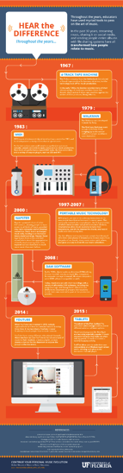


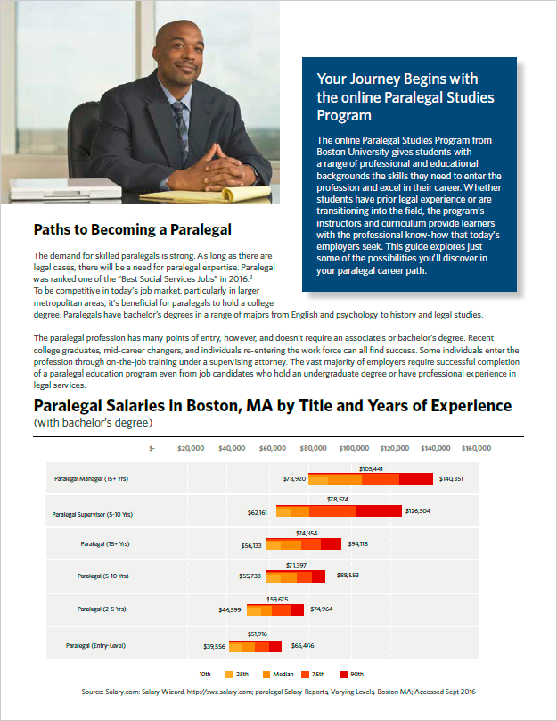
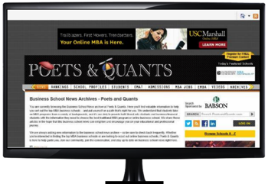
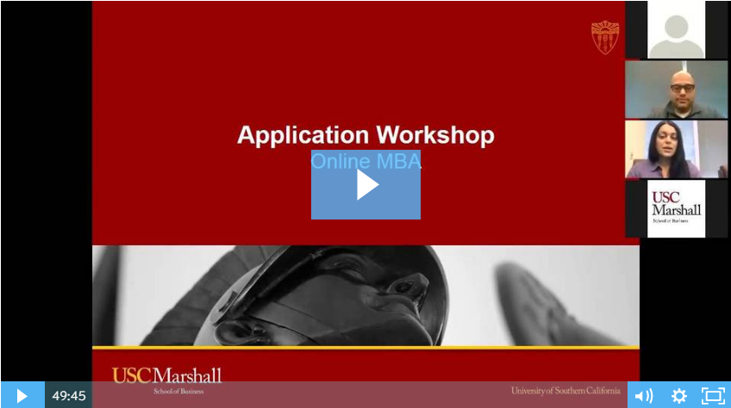
Ongoing Creative Services
Timely website content updates
Creative updates based on “winning” design elements
Support media as applicable:
  Webinars
  Career guides
  Digital and traditional radio
  Video editing
  Infographics
  Print media
  Outdoor media
  Articles & press releases

Slide 12
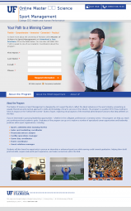
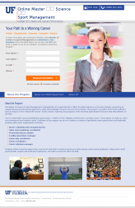
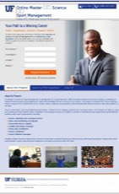
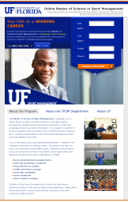
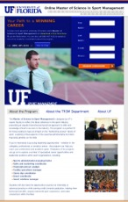
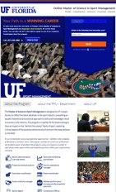
Landing Page Optimization
Best practices at launch, understanding that each target is different
Evolve as dictated by the data: imagery, content, form position, form fields, etc.
Improves efficiency of media spend
Current
9%
Conversion Rate from Visit to Inquiry
15%

Slide 13


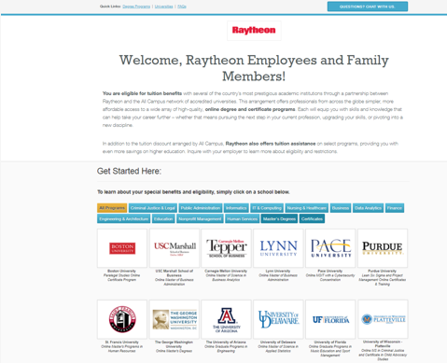





Corporate Partner Portal
Partnership with the largest benefits providers and direct companies (1,000+) connects our clients to over 20 million professionals around the globe

Slide 14
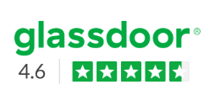


Best Places to Work
All Campus recognized as a “Best Places to Work” in Chicago
  Built In Chicago
    #20 Best Places to Work in Chicago
    #7 Best Small Companies to Work for in Chicago
  Crain’s Chicago Business
    #32 Best Places to Work in Chicago
    #19 Best Small Companies to Work for in Chicago

Slide 15
Current Program Update

Slide 16
Live and Upcoming Pace & All Campus Programs
Full marketing and recruitment for:
  Master of Science in Information Technology (first start: Summer 2018)
  Master of Arts in Homeland Security (first start: Spring 2019)
  Degree Completion programs/iPace (first start: early Spring 2019)
Partial marketing and recruitment for:
  MA in Higher Education Administration and Student Affairs (full go-live in Spring 2020)
Upcoming program launches:
  MSEd in Literacy Education; Advanced Certificate, Literacy Specialist
  MBA
  Masters of Public Administration (pending re-launch)

Slide 17
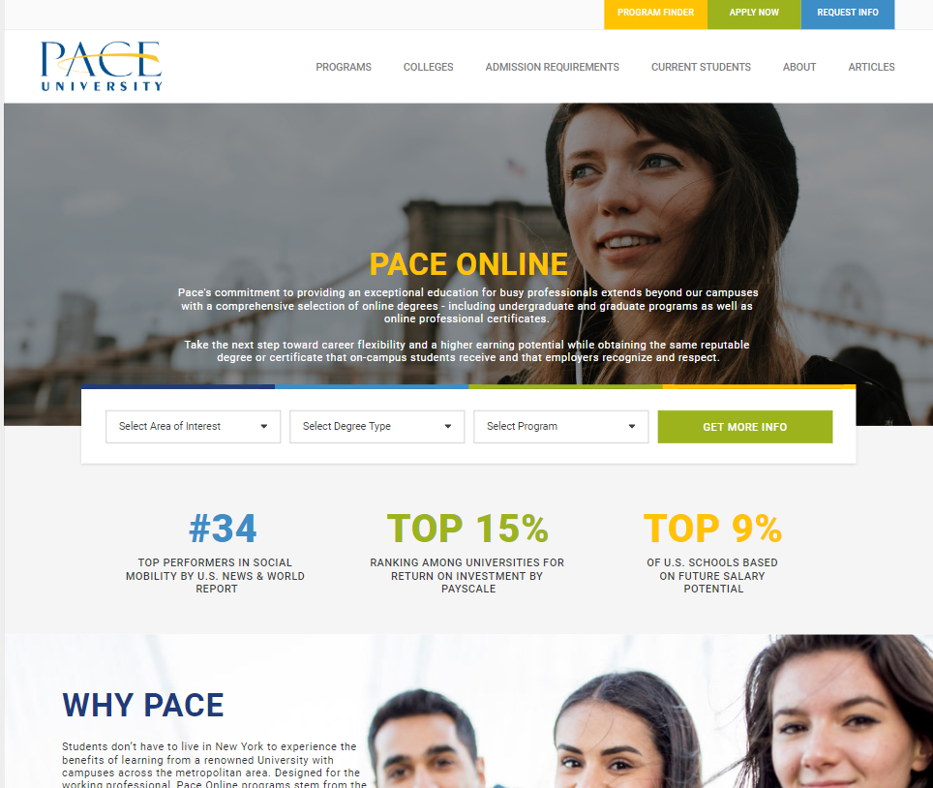
Development of online.pace.edu Subdomain
All programs linked to from the online.pace.edu site, whether managed by Pace or All Campus, will benefit from search engine optimization approach
Link building efforts will be combined into one site, rather than spread across three (degree completion, MSIT, Homeland Security) creating economies of scale
Site will increase interlinking opportunities between graduate and undergraduate programs, on-ground and online programs
Site architecture hierarchy is optimized for search engines
Over time, the online.pace.edu site will rank #1 for any branded, “online” search query
Preparing to launch in Q1 2020

Slide 18
New Students, Graduate Programs

Slide 19
New Students, Degree Completion Programs

Slide 20
MSIT: Fall YOY Metrics
Significant increase in applications started, applications submitted, accepted and attending students
Slight decrease in submission rate due to increase in application volume
12% increase in show rate
Status | 2018 | 2019 | % Change YOY
Apps Started | 35 | 58 | 66%
Apps Submitted | 27 | 37 | 37%
Accepted | 25 | 34 | 36%
Attending | 14 | 23 | 64%
% Submitted | 77% | 64% | -13%
% Accepted | 93% | 92% | -1%
Show Rate | 56% | 68% | 12%

Slide 21
MAHS: Fall YOY Metrics
Significant increase in applications started, applications submitted, accepted and attending students
20% increase in submission rate, 7% increase in show rate
Status | 2018 | 2019 | % Change YOY
Apps Started | 5 | 25 | 400%
Apps Submitted | 3 | 20 | 567%
Accepted | 3 | 19 | 533%
Attending | 2 | 14 | 600%
% Submitted | 60% | 80% | 20%
% Accepted | 100% | 95% | -5%
Show Rate | 67% | 74% | 7%

Slide 22
2019 Marketing Highlights and Accomplishments
SEO
  Published 7 articles across all programs in 2019 with more in development for 2020
  Increased link building efforts – there are now 153 linking domains and 351,705 backlinks to the sites All Campus manages on Pace’s behalf
  Search traffic has increased because of improved keyword rankings
Paid media and niche marketing
  94% increase in click-through-rates in search campaigns over last 6 months
  32% increase in social inquiries in Q3 compared to Q2
  22% increase in Absolute Impression share (appearing in the top 3 positions in the search) over last 6 months
  Positive results in niche marketing efforts for graduate programs
Completed and on-going design tests are informing site design and content approach
Development and launch of online.pace.edu subdomain presents a powerful marketing opportunity for both Pace and All Campus

Slide 23
Recent Accomplishments and New Initiatives
Finalizing Slate adoption for all online programs managed by All Campus
  Anticipating improved reporting, process, and communication flows between All Campus and Pace
  Refining process maps to reflect new approaches
Finalizing online.pace.edu design and content with launch planned for Q1 2020
Identifying new specializations within the MSIT program to launch with an eye towards additional fully online programs following
Launching initiative related to the online Homeland Security degree to increase visibility and marketability
Developing plan to re-launch iPace/degree completions to improve marketability and program performance (2020)
Expanding recruitment to Massachusetts and California

Slide 24
Thank you!

