Slide 1


Pace University
Instructional Design Support Services Panel
Session Summary: A panel of faculty support members will discuss their roles, how they collaborate with each other, and the process faculty should follow when developing a course. An overview of current training sessions offered to faculty will be discussed with an emphasis on the initiative to follow Quality Matters best practices in course design
January 21,2020
Notes:
note

Slide 2
Presenters
Dr. Beth Gordon-Assistant Vice President of Information Technology Services, Academic and Administrative Services
Joe Seijo- Assistant Director/Instructional Designer, Faculty Center
Dr. John Blackwell-Manager of Academic Technology
Nancy Uhl- Assistant Director of Instructional Design, Pace Online
Nick Rudzwick- Director of IT, Pace Online
Notes:
Each person can introduce themselves then use 8-10 minutes to showcase their unit. Ex, Beth can show the digital toolkit, Joe can show a glimpse into the faculty training, etc. Nick can close this slide by showcasing the Faculty Media Center ( Jaime will speak to it, but Nick can provide a “tour”)

Slide 3
Teaching Effectively Online workshop

Slide 4
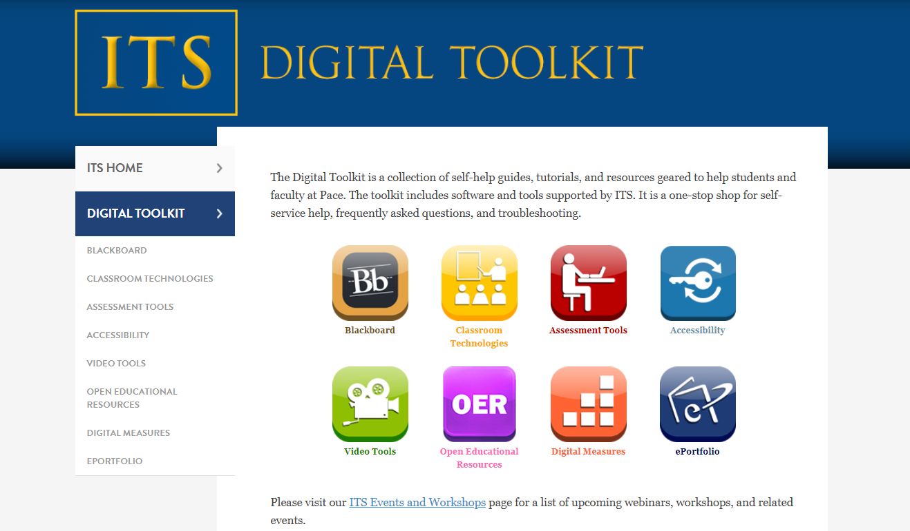
www.pace.edu/digitaltoolkit

Slide 5
Pace Online Instructional Design Support
Assist with the selection of course materials e.g. textbooks, videos etc.
Assist with the development of the syllabus including Student Learning Objectives
Assist with course material creation: graphics, html documents, simple video, publisher material integration into Blackboard, set up and scheduling of Blackboard materials, creation of assessments and rubrics, ProctorU set up with the assistance of Tricia Vogel
Ensure ADA compliance

Slide 6
Quality Assurance
After the course is fully developed the course can be reviewed with the Quality Matters rubric. Our goal is to achieve a score of 85% or better.
Course Overview and Introduction
Learning Objectives
Assessment and Measurement
Instructional Materials
Course technology
Learner Support
Accessibility and Usability

Slide 7
Feedback
All courses are evaluated using the Blue course evaluation system
Feedback is reviewed and adjustments to the course are made
We review courses early on (week 4) to ensure things are running smoothly and make any course corrections necessary

Slide 8

Timeline
All course development should be
completed and all materials delivered at least
4 weeks prior to the beginning of the semester
in which the course is scheduled to run.
Recommended Timeline (4-6 months recommended)
Continued

Slide 9
Faculty Media Center
Coming soon! Center will be located on 6th floor of 1 Pace Plaza.
Center will manage the media components, synchronous course sessions, and overall online course elements beyond basic instructional design.
Classroom available for live, synchronous class sessions.

Slide 10
Faculty Media Center
Notes:
Nick to add screen shot of center and provide a brief overview of equipment and lay out

Slide 11
Contact Information
Academic Technology: acadtech@pace.edu
IT Help Desk: Pacehelpdesk@pace.edu
Faculty Center: Facultycenter@Pace.edu
Pace Online Instructional Design: Instructionaldesign@pace.edu
Ed Media
New York Campus E312 Department Phone: (212) 346-1583 | Pleasantville Campus Miller Hall 31 Department Phone: (914) 773-3338 | White Plains Campus Aloysia Hall 303 Department Phone: (914) 422-4060
Notes:
UTelephone: (914) 773-3333
UToll Free: 1 (855) 722-3487
MEmail: pacehelpdesk@pace.edu
GOnline: help.pace.edu

Slide 12

Questions?

