Slide 1


Pace University
Professional Education and Special Programs
Pace Online Conference
Presented by
Shawn O’Riley, Ed.D.
Associate Vice President,
Professional Education and Special Programs
January 21, 2020

Slide 2
Online Higher Education:
National and Pace Trends

Slide 3
Online Higher Education: Current Trends
In 2017*, 29% of all graduate students were in fully online degree programs. 38% of all graduate students had taken at least one online course. 13% of all undergraduate students in fully online programs.
The majority (57%)of all online students enroll in their home state
2012-2016**
  Total higher education enrollment has declined by 3.8%
  The number of students not taking any online classes declined 11.2%
  Online higher education enrollment increased by 17.2%
  Sources: *NCES, **Babson Research Group

Slide 4
Pace Total Online Sections
Term | Level | Sections | Enrollment | Ave. Section Size | Section Cr. Hrs.
Fall 2015 | Undergraduate | 197 | 3,268 | 16.6 | 9,992.0
Fall 2015 | Graduate | 90 | 1,398 | 15.5 | 4,122.0
Fall 2015 | Totals | 287 | 4,666 | 16.3 | 14,114.0
Fall 2016 | Undergraduate | 208 | 3,446 | 16.6 | 10,598.0
Fall 2016 | Graduate | 97 | 1,557 | 16.1 | 4,564.5
Fall 2016 | Totals | 305 | 5,003 | 16.4 | 15,162.5
Fall 2017 | Undergraduate | 235 | 3,885 | 16.5 | 11,721.0
Fall 2017 | Graduate | 110 | 1,657 | 15.1 | 4,620.5
Fall 2017 | Totals | 345 | 5,542 | 16.1 | 16,341.5
Fall 2018 | Undergraduate | 259 | 4,295 | 16.6 | 12,922.0
Fall 2018 | Graduate | 128 | 2,411 | 18.8 | 6,459.0
Fall 2018 | Totals | 387 | 6,706 | 17.3 | 19,381.0
Fall 2019 | Undergraduate | 261 | 4,636 | 17.8 | 13,874.0
Fall 2019 | Graduate | 165 | 2,692 | 16.3 | 6,940.0
Fall 2019 | Totals | 426 | 7,328 | 17.2 | 20,814.0
Notes: Sections up 67%, Enrollment up 64%, Credit hours up 68% in five years

Slide 5
Pace Online – Enrollment Update
Program | Fall 2016 | Fall 2017 | Fall 2018 | Fall 2019
NACTEL Undergrad | 227 | 156 | 117 | 91
iPace* | 140 | 122 | 106 (first All Campus semester) | 99
MA Homeland Security* | 19 | 14 | 10 (first All Campus semester) | 24
MS Information Technology (NACTEL) | 63 | 74 | 74 | 58
MS Information Technology* |  |  | 16 (first All Campus semester) | 56
MA History (GLI) |  |  | 355 | 423
*All Campus affiliated program

Slide 6
Total Pace Enrollment, Age 25+
Student Level | Fall 2015 | Fall 2016 | Fall 2017 | Fall 2018 | Fall 2019
Undergraduate | 892 | 833 | 755 | 732 | 626
 |  |  |  | Fall 2019 Total Pace | 8,745
Graduate | 2,421 | 2,526 | 2,419 | 2,789 | 2,940
 |  |  |  | Fall 2019 Total Pace | 4,867
Total | 3,599 | 3,647 | 3,463 | 3,816 | 3,904
 |  |  |  | Fall 2019 Total Pace | 13,612
Note: 7% of all Pace undergraduates are over the age of 25. Nationally, 8% of private, nonprofit undergraduate students and 27% of all undergraduate students are aged 25 or higher.

Slide 7
Example: Determining Estimated Online Student Markets

Slide 8
Accounting – Market Size (IPEDS)
National: Total completions in 2017: 19,656. 487 total institutions reporting graduates (online and on-campus). 95 institutions reporting an online option.
State: SUNY at Binghamton (#6, 215 graduates), and CUNY Bernard M Baruch College (#8, 205 graduates) for campus programs. St. John’s University (#20, 145 graduates), and St Bonaventure University (#18, 286 graduates) for online programs. Pace University (#34, 124 graduates).
Rank | Completions | Institution | Inst Size
2 | 390 | University of Illinois at Urbana-Champaign | 20,000 and above
3 | 380 | The University of Texas at Dallas | 20,000 and above
4 | 303 | The University of Texas at Austin | 20,000 and above
5 | 275 | Southern New Hampshire University | 20,000 and above
6 | 215 | SUNY at Binghamton | 10,000 - 19,999
7 | 210 | Liberty University | 20,000 and above
8 | 205 | CUNY Bernard M Baruch College | 10,000 - 19,999
9 | 198 | Fordham University | 10,000 - 19,999
10 | 177 | University of Maryland-College Park | 20,000 and above
11 | 170 | DePaul University | 20,000 and above
13 | 162 | University of Utah | 20,000 and above
14 | 160 | University of Houston | 20,000 and above
15 | 159 | Florida Atlantic University | 20,000 and above
16 | 158 | University of Missouri-Columbia | 20,000 and above
17 | 155 | Bentley University | 5,000 - 9,999
18 | 150 | Texas A & M University-College Station | 20,000 and above
19 | 147 | Pennsylvania State University-Main Campus | 20,000 and above
20 | 145 | St John's University-New York | 20,000 and above
21 | 144 | University of Georgia | 20,000 and above
22 | 142 | University of Kansas | 20,000 and above
Legend
On-Campus Only
Online Offered
In-State & On-Campus Only
In-State & Online Offered
Completions include total sum of on-campus and online completions, if online offered
*IPEDS was pulled from CIP code Accounting, 52.0301

Slide 9
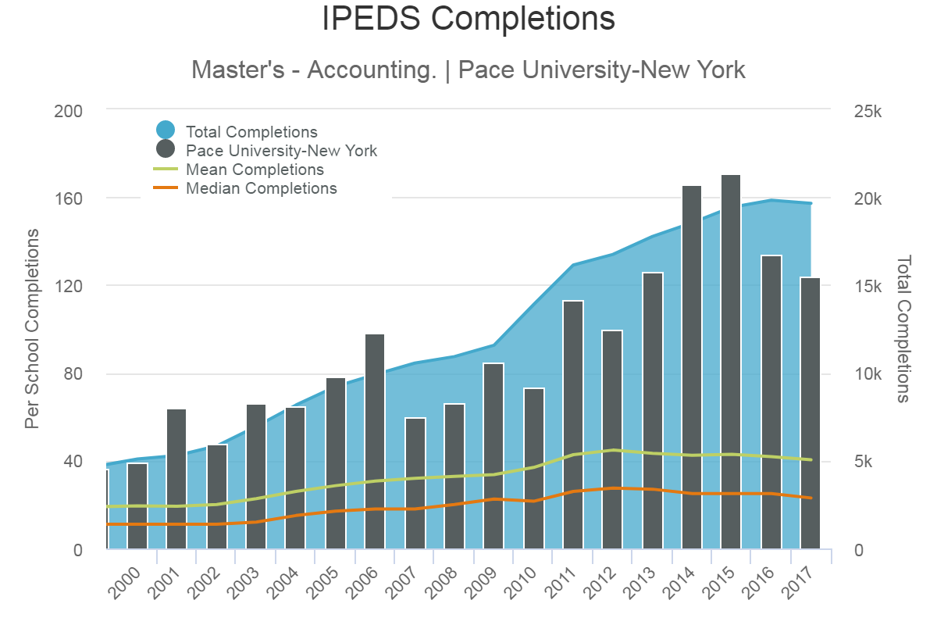
Accounting – IPEDS Trends
Year | Total Institutions | Total Completions | Average Completions | Online Institutions | Online Completions
2000 | 263 | 5,093 | 19.4 | - | -
2001 | 276 | 5,291 | 19.2 | - | -
2002 | 292 | 5,837 | 20 | - | -
2003 | 306 | 6,946 | 22.7 | - | -
2004 | 314 | 8,166 | 26 | - | -
2005 | 322 | 9,221 | 28.6 | - | -
2006 | 323 | 9,903 | 30.7 | - | -
2007 | 331 | 10,555 | 31.9 | - | -
2008 | 333 | 10,926 | 32.8 | - | -
2009 | 344 | 11,572 | 33.6 | - | -
2010 | 376 | 13,891 | 36.9 | - | -
2011 | 378 | 16,139 | 42.7 | - | -
2012 | 374 | 16,743 | 44.8 | - | -
2013 | 410 | 17,765 | 43.3 | 57 | 3,085
2014 | 437 | 18,548 | 42.4 | 70 | 3,655
2015 | 453 | 19,429 | 42.9 | 86 | 4,385
2016 | 474 | 19,826 | 41.8 | 95 | 4,772
2017 | 487 | 19,656 | 40.4 | 95 | 4,552
*IPEDS was pulled from CIP code Accounting, 52.0301

Slide 10
MS in Accounting – Regional* Market Size (IPEDS)
Institutions | Completions | Online Institutions | Online Completions
90 | 3,400 | 15 | 559
Average Completions | 38
Average Online Completions | 37
Market Share Requirement** | 1.47%
Online Market Share Requirement** | 8.94%
Calculating Market Share Requirements to hit 50 New Annual Enrollments
Market Share Requirement:
50 New Annual Enrollments / 3,400 Regional Completions = .0147
.0147*100 = 1.47%
Online Market Share Requirement:
50 New Annual Enrollments / 559 Regional Online Completions = .0894
.0894*100 = 8.94%
*Regional Defined as New York, New Jersey, Connecticut, and Pennsylvania
**Estimate based on 50 new annual enrollments
***IPEDS was pulled from CIP code Accounting, 52.0301

Slide 11
Accounting – Competitive Overview
Search Volume | U.S. News Rankings (2019) |  |  |  |  | Institution | Program Name | Total Tuition | Cost Per Credit Hour | Total Credits
 | Full-Time MBA | Part-Time MBA | Online MBA | Online Graduate (Non-MBA) | Graduate Accounting
165,000 | 70 | unranked | 42 | 56 | unranked | Syracuse University | M.S. in Professional Accounting | $46,770 | $1,559 | 30
74,000 | unranked | 101 | unranked | 45 | unranked | St. John's University | M.S. in Accounting | $37,350 | $1,245 | 30
90,500 | unranked | unranked | unranked | unranked | unranked | Pace University | M.S. in Accounting - CPA Preparation | $38,010 | $1,267 | 30
33,100 | unranked | 206 | unranked | 55 | unranked | Rider University | Master of Accountancy | $33,000 | $1,100 | 30
6,600 | unranked | unranked | 125 | 79 | unranked | SUNY Polytechnic Institute * | M.S. in Accounting | $30,525 | $925 | 33
165,000 | 44 | 39 | 61 | 21 | unranked | Rutgers University | Master of Accountancy (Governmental Accounting) | $28,350 | $945 | 30
450,000 | 31 | 172 | 10 | 5 | unranked | Penn State-World Campus | Master of Professional Accounting | $27,900 | $930 | 30
22,200 | unranked | unranked | 128 | 118 | unranked | New England College | M.S. in Accounting | $27,200 | $680 | 40
22,200 | unranked | 74 | 108 | 83 | 28 | University of Scranton | Master of Accountancy | $26,850 | $895 | 30
40,500 | 85 | 74 | unranked | 6 | unranked | University of Connecticut | M.S. in Accounting | $25,500 | $850 | 30
18,100 | unranked | unranked | unranked | unranked | unranked | Western New England University | M.S. in Accounting | $25,470 | $849 | 30
5,400 | unranked | unranked | unranked | unranked | unranked | Albertus Magnus College | M.S. in Accounting | $25,140 | $838 | 30
90,500 | 55 | 25 | 16 | 36 | unranked | UMass-Amherst | Master in Accountancy | $24,000 | $800 | 30
9,900 | unranked | unranked | unranked | unranked | unranked | Bay Path University | M.S. in Accounting | $24,900 | $830 | 30
165,000 | 48 | 15 | 9 | unranked | unranked | University of Maryland* | M.S. in Accounting and Financial Management | $23,724 | $659 | 36
74,000 | unranked | unranked | unranked | unranked | unranked | Southern New Hampshire University | M.S. in Accounting | $22,572 | $627 | 36
18,100 | unranked | unranked | unranked | unranked | unranked | Nichols College | M.S. in Accounting | $21,900 | $608 | 36
40,500 | unranked | unranked | 196 | unranked | unranked | University of Hartford | M.S. in Accounting and Taxation (Taxation) | $20,850 | $695 | 30
49,500 | unranked | 118 | 47 | 30 | unranked | UMass-Lowell | M.S. in Accounting | $19,650 | $655 | 30
27,100 | unranked | unranked | unranked | unranked | unranked | Plymouth State University * | M.S. in Accounting | $18,150 | $605 | 30
18,100 | unranked | 201 | 100 | 92 | unranked | Clarion University of Pennsylvania** | M.S. in Accounting | $16,710 | $557 | 30
* Non-Resident **Non-Resident Online

Slide 12
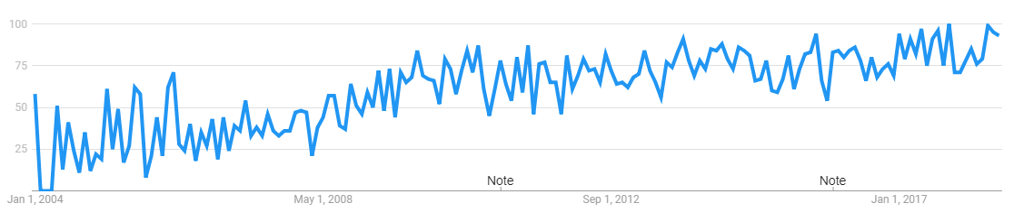
Accounting – Average Monthly Searches - National
Average Monthly Searches: Very high number of searches with a very high number of online degree seekers
Above average ratio of 46% “online” degree seekers compared to 14.5% average “online masters program” searches
General Key Term | Avg. Monthly Searches | "Online" Qualified Search Volume
masters in accounting | 6,600 | 3,490
masters degree in accounting | 1,600 | 0
accounting masters programs | 1,000 | 0
master of science in accounting | 590 | 90
macc degree | 480 | 30
ms in accounting | 480 | 320
accounting graduate programs | 320 | 0
ma accounting | 140 | 0
master of science in accountancy | 140 | 20
graduate degree in accounting | 110 | 0
macc programs | 110 | 170
accounting ma | 70 | 0
masters degree accounting | 70 | 920
ma accountancy | 10 | 0
masters degree accountancy | 10 | 0
accounting graduate degree | 0 | 30
macc * | - | 350
Total | 11,730 | 5,420
“masters in accounting”
* Average monthly searches for “macc” are not included in the chart due to alternative meanings for the search term

Slide 13
Accounting – Average Monthly Searches – Regional*
Average Monthly Searches: Very high number of searches with a very high number of online degree seekers
Above average ratio of 49% “online” degree seekers compared to 14.5% average “online masters program” searches
General Key Term | Avg. Monthly Searches | "Online" Qualified Search Volume
masters in accounting | 1,000 | 460
masters degree in accounting | 210 | 90
ms in accounting | 170 | 50
accounting masters programs | 140 | -
master of science in accounting | 90 | 10
macc degree | 70 | 10
accounting graduate programs | 40 | 260
accountant ma | 30 | -
master of science in accountancy | 20 | 10
ma accounting | 20 | -
macc programs | 10 | 10
masters degree accounting | 10 | 10
graduate degree in accounting | 10 | -
ma accountancy | 10 | -
masters degree accountancy | 10 | -
Total | 1,840 | 910
*Regional Defined as New York, New Jersey, Connecticut, and Pennsylvania

Slide 14
Pace Online Overview

Slide 15
Pace Online – Moving to a Service Model
Pace Online will support all online efforts across all levels, programs, and campuses at Pace University
  Administrative support and funding for market research, marketing, recruiting, admissions, orientations, student services, faculty training and development, and course development available to units
Pace Online funded like other support units at the university
Budget implications
  Colleges will directly receive all online program tuition and fees
  Colleges will be responsible for faculty staffing and pay for online sections
  Pace Online can support or cover other expenses related to online programs

Slide 16
Pace Online – Services Offered
Market research
Consultation on preparation for online launches
Assistance with internal and external approvals and authorizations
Marketing and recruiting
  Through our All Campus partnership and through internal resources
Advising and student support
Faculty training and online course design support
  Including instructional design, digital media production, and orientations

Slide 17
Pace Online – Suggested Coding Changes
Working with registrar, admissions, OPAIR, and finance to establish a new coding system for online programs, students, sections, and faculty
NC SARA OOS placement tracking
  NC SARA allows for online reciprocity in 49 states
  They are now requiring us to track and report all out of state placements, even for non-online programs

Slide 18
Pace Online Programmatic Initiatives
20-21 Academic Year
  Programs launching or re-launching
    Online MBA
    MA Higher Education Administration
    MS Ed/Advanced Certificate Literacy
    iPace name phase out and adult undergraduate programs launches
21-22 Academic Year
  Programs planned for launch
    MS Accounting
    Online Masters in Data Science
    Online Masters in Cybersecurity
    Several others in discussion
Moving Forward: Likely 4-6 online program launches each year for next few years

